Slide 1
SecureShe-Real Time Women Safety Alert System
DEPARTMENT OF AIML (AIM) – IV-II Sem Project Review
Project batch No: A-3
PROJECT BY: PROJECT GUIDE:
TL : M. Sai Deepthi(21BQ1A6142) Mrs.N. Nalini Krupa
TM1: C.Leela Manjunath( 21BQ1A6115)
TM2: N.Prasanna Kumar (22BQ5A6104)
TM3: M. Revanth ( 21BQ1A6140)

Slide 2
Contents
Abstract
Introduction
Existing system
Proposed system
Architecture
Algorithm
Visualization
Software Requirements
Hardware Requirements
Applications

Slide 3
Abstract
SecureShe-Real Time Women Safety Alert System is an advanced AI-powered surveillance solution designed to proactively enhance women's safety in public spaces. Leveraging the power of computer vision, deep learning, and gesture recognition, the system offers real-time monitoring to detect and prevent potentially dangerous situations. Unlike traditional safety systems that rely on reactive measures or victim-initiated alerts, this solution provides continuous, automated surveillance with a specific focus on women’s safety.
Key functionalities include person detection combined with gender classification, enabling accurate analysis of gender distribution in monitored areas. The system can detect high-risk scenarios such as a lone woman during nighttime or a woman surrounded by multiple men, which often indicate vulnerability. Additionally, it recognizes distress gestures (such as SOS signals) and identifies the presence of weapons, triggering immediate alerts to law enforcement for rapid intervention.
By offering predictive analytics and real-time threat detection, Women Safety Analytics transforms public safety from a reactive to a proactive model, empowering authorities to prevent incidents before they escalate and ensuring safer environments for women.

Slide 4
Introduction
Women Safety Analytics is a cutting-edge, AI-powered solution that leverages real-time monitoring to detect and prevent potential threats to women's safety. By incorporating computer vision, deep learning, and gesture recognition technologies, this software continuously analyses environments to detect suspicious or unsafe situations, particularly for women. It employs a combination of person detection, gender classification, anomaly detection, and predictive analytics to identify potential threats and trigger timely alerts.
The system will monitor public spaces, streets, and other critical areas to count the number of men and women present, providing insights into gender distribution patterns at specific times and locations. It is designed to identify risky situations such as a lone woman at night, a woman surrounded by men, or unusual gestures indicating distress. By offering real-time data and early alerts, Women Safety Analytics empowers law enforcement to respond swiftly and prevent potential incidents before they escalate.

Slide 5
Existing System
Existing systems for women’s safety primarily include CCTV surveillance, mobile safety applications, AI-powered anomaly detection platforms, and public safety hotlines. While these tools have made strides in improving general security, they often fall short when it comes to proactive and women-specific threat detection. For instance, CCTV cameras provide passive monitoring and usually require manual supervision or review of footage after an incident has occurred. This makes them reactive rather than preventive, limiting their ability to intervene in real-time. Similarly, AI-based anomaly detection systems in public areas typically focus on generic threats or behavioral irregularities without specifically identifying gender-sensitive scenarios, such as a woman being followed or harassed.
Mobile safety apps and emergency hotlines offer direct communication channels for victims to request help, but they come with their own limitations. These systems rely heavily on the user’s ability to recognize danger and respond quickly, which may not be feasible in high-stress or life-threatening situations.

Slide 6
Victims may be unable to access their devices, make a call, or send an alert if they are restrained, unconscious, or afraid of escalating the situation. Additionally, many of these apps require location services or internet connectivity, which may not always be reliable. Overall, while these existing solutions contribute to safety infrastructure, they do not adequately address the need for automated, intelligent systems that can detect and respond to threats specific to women without requiring manual input.
To truly enhance women’s safety in public spaces, there is a need for a more advanced, proactive, and gender-focused approach that bridges the gaps left by current solutions. Such systems should be capable of recognizing patterns and scenarios that are statistically more dangerous for women, including being alone at night, surrounded by unfamiliar men, or displaying distress gestures. By incorporating real-time surveillance powered by AI, computer vision, and deep learning technologies, it becomes possible to detect threats as they emerge and immediately notify authorities for intervention. This next-generation approach would mark a significant shift from post-incident response to real-time prevention, ensuring safer environments tailored specifically to the unique safety needs of women.

Slide 7
Proposed System
Our proposal focuses on developing a proactive, real-time threat detection system using AI-powered surveillance and advanced analytics specifically tailored for women's safety. our solution leverages cutting-edge technologies such as computer vision, machine learning, and gesture recognition to create a fully automated system that continuously monitors public spaces. The system employs sophisticated algorithms for person detection and gender classification, enabling it to analyze the environment in real time and provide valuable insights into gender distribution patterns. This data can help identify high-risk areas and times, such as isolated streets at night or densely crowded events, where the potential for unsafe situations increases.
A core strength of the system lies in its ability to recognize specific scenarios that could pose a threat to women. For instance, it can detect if a woman is alone in a poorly lit area at night or if she is surrounded by a group of men—both considered indicators of vulnerability. Additionally, the integration of gesture analytics allows the system to interpret emergency signals, such as SOS gestures, which may be the only way a victim can silently request help. The moment such a situation is identified, the system can trigger automated alerts to law enforcement drastically reducing response time and potentially preventing an incident before it occurs.

Slide 8
By removing the need for manual input and focusing on predictive, gender-aware threat detection, our proposal aims to fill the critical gaps left by existing safety technologies, offering a smarter, faster, and more inclusive approach to public safety for women.
SecureShe-Real Time Women Safety Alert System include the following functionalities .
Person detection along with Gender Classification
Gender Distribution : Count the number of men and women present in
the scene
Identifying a Lone Woman at Night time
Detection of a weapon
Recognizing SOS situation through gesture analytics.
Detection of a Woman Surrounded by Men

Slide 9
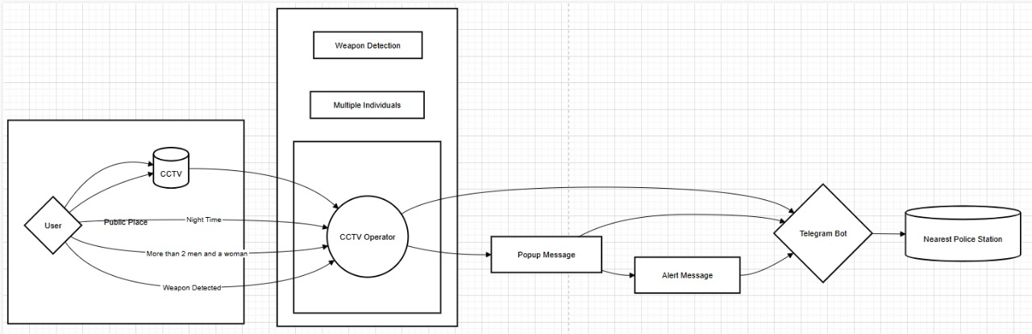
Architecture

Slide 10
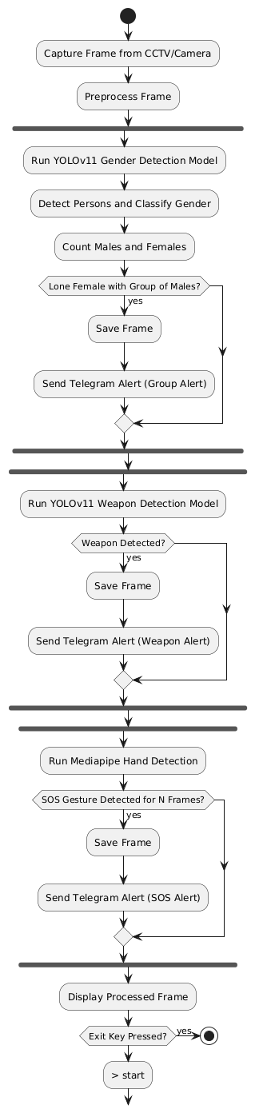
Algorithm

Slide 11
1. Input Layer – CCTV/Camera Feed
The system begins with live video input from surveillance cameras or CCTV.
Frames are extracted in real-time for analysis.
2. Pre-processing Module
Captured frames undergo resizing, normalization, and color space conversion
(if needed) to prepare for model input.
Frame data is formatted for YOLOv11 and MediaPipe processing.
3. Detection & Recognition Modules
a. YOLOv11 Gender Detection Model
YOLOv11 is used for object detection and gender classification.
Each detected person is classified as Male, Female, or Background.
Bounding boxes and class labels are overlaid on frames.
b. MediaPipe Gesture Recognition
MediaPipe processes the same frames to detect 21 hand landmarks.
It analyzes the hand posture to identify specific SOS gestures (e.g., hand wave or
specific finger positioning).

Slide 12
4. Analytical Logic Layer
a. Lone Female Detection
Counts the number of males and females in the frame.
If only one female is surrounded by multiple males, the system flags it as a
critical situation.
b. SOS Gesture Trigger
If an SOS gesture is detected, it acts as a manual trigger for sending alerts,
even without group logic detection.
5. Alert & Communication Module
a. Telegram Bot API Integration
The system captures the current frame and sends a real-time alert via Telegram.
The message includes the captured image, alert type, and optionally location or
timestamp.
6. Output & Storage
Alert frames can be stored locally or in a cloud database for future review.
Logs of alerts and detected events are maintained for audit trails.

Slide 13
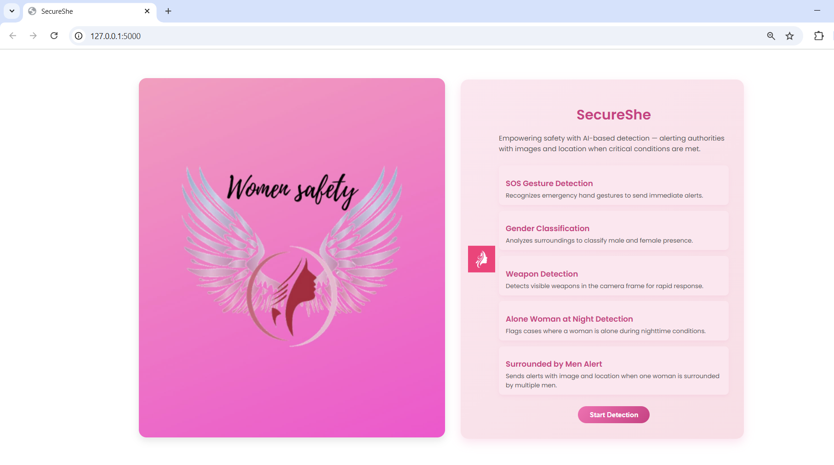
Visualization
Display Page

Slide 14
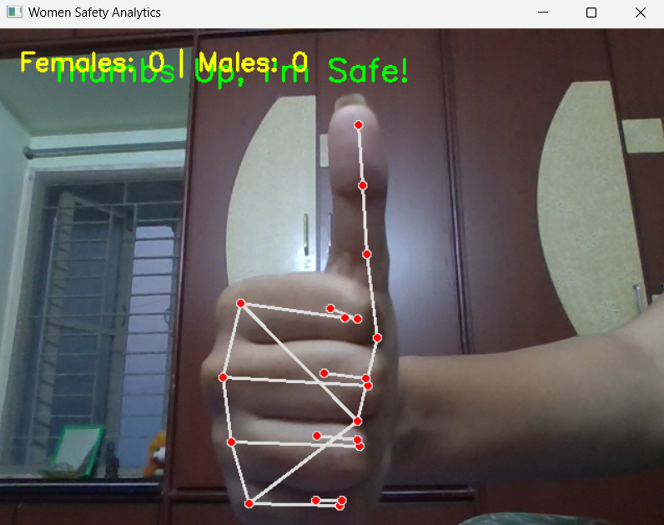
Safe Gesture Detection

Slide 15

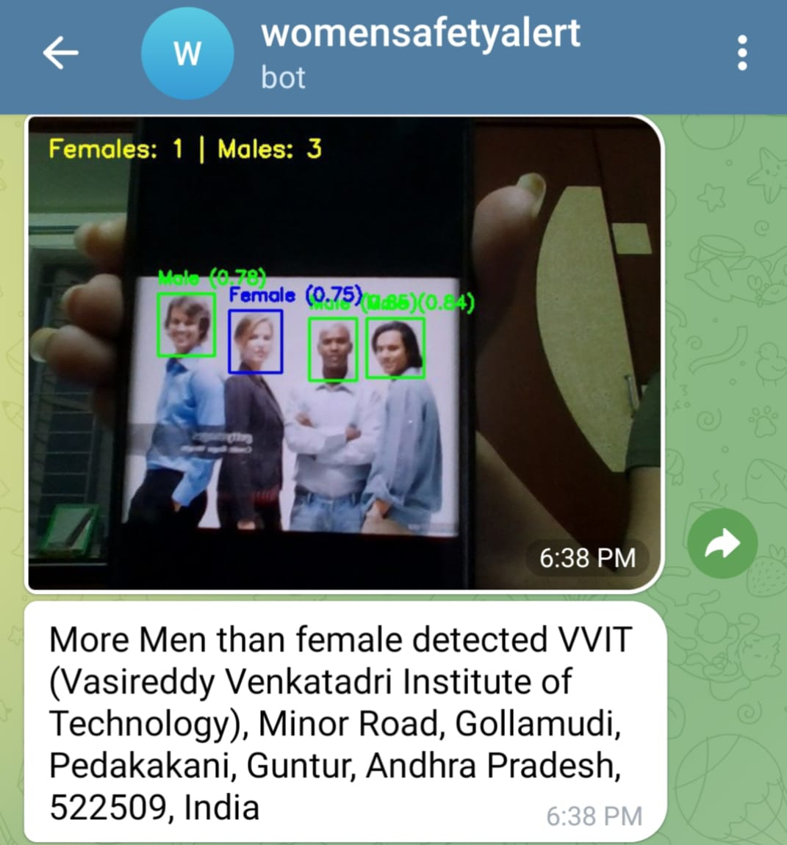
More Men than Female Detection
Input
Output

Slide 16

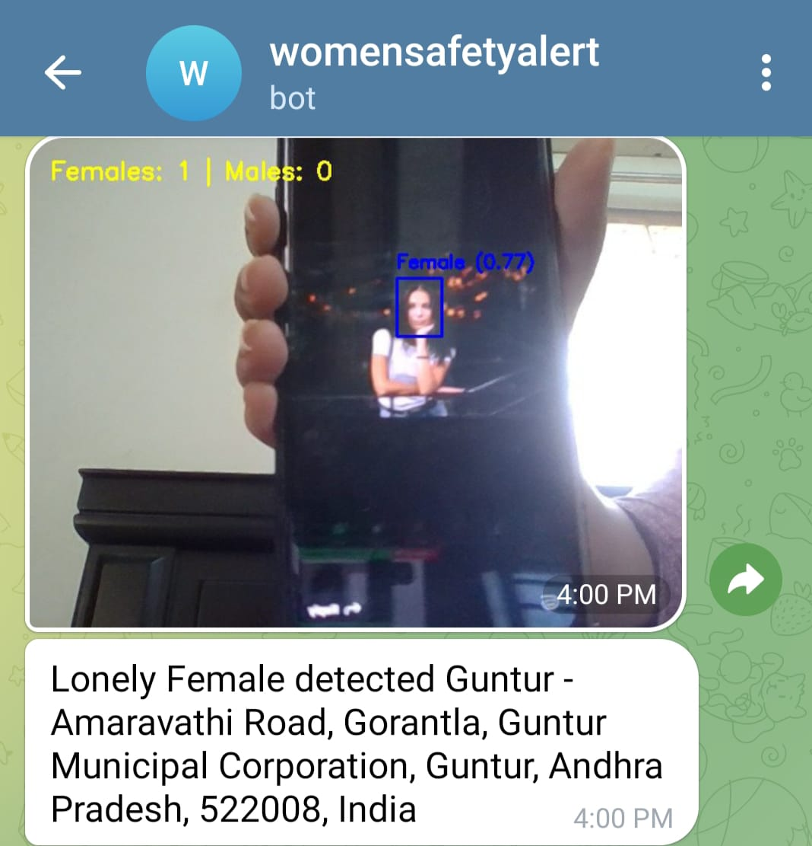
Alone Female Detection at Night
Input
Output

Slide 17
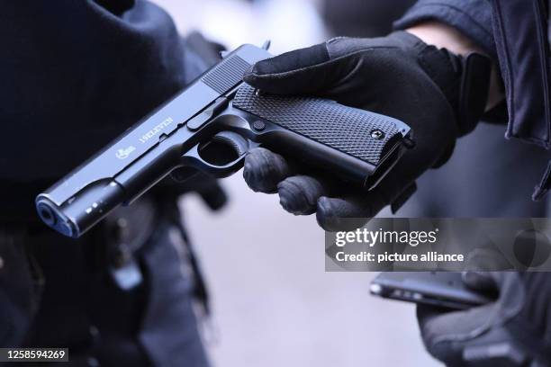
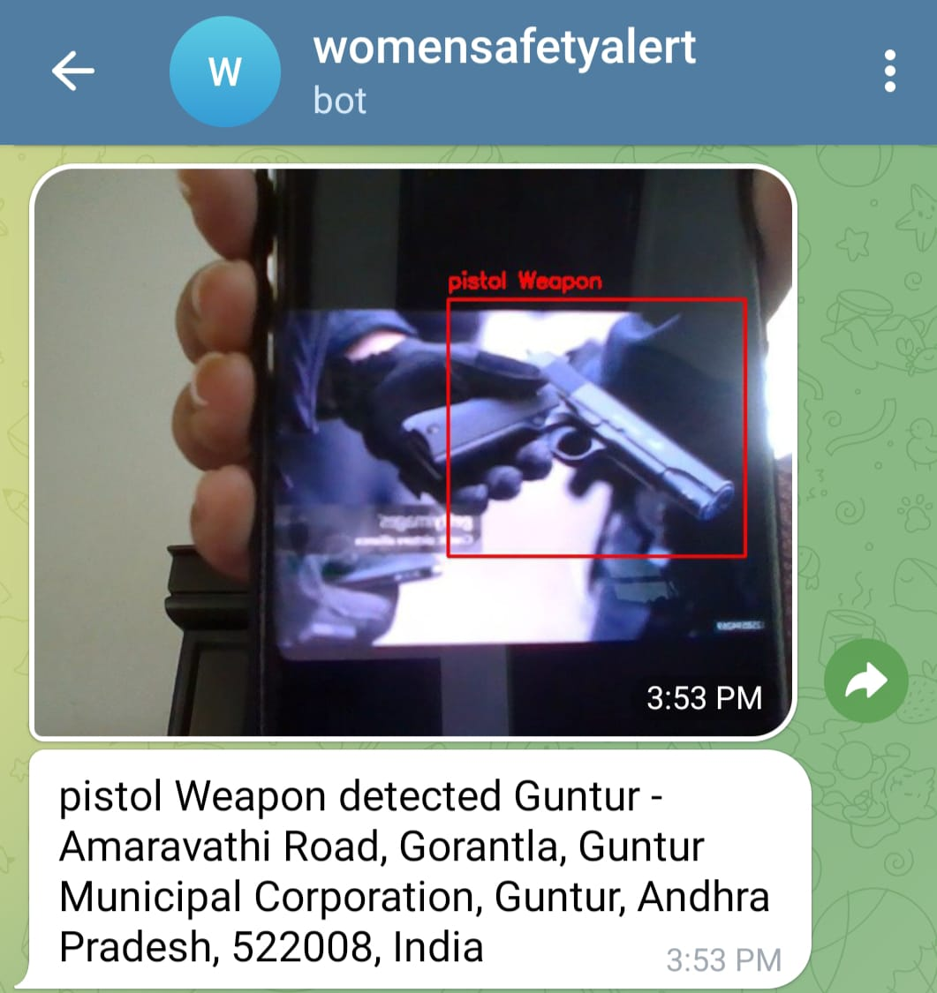
Pistol Weapon Detection
Input
Output

Slide 18
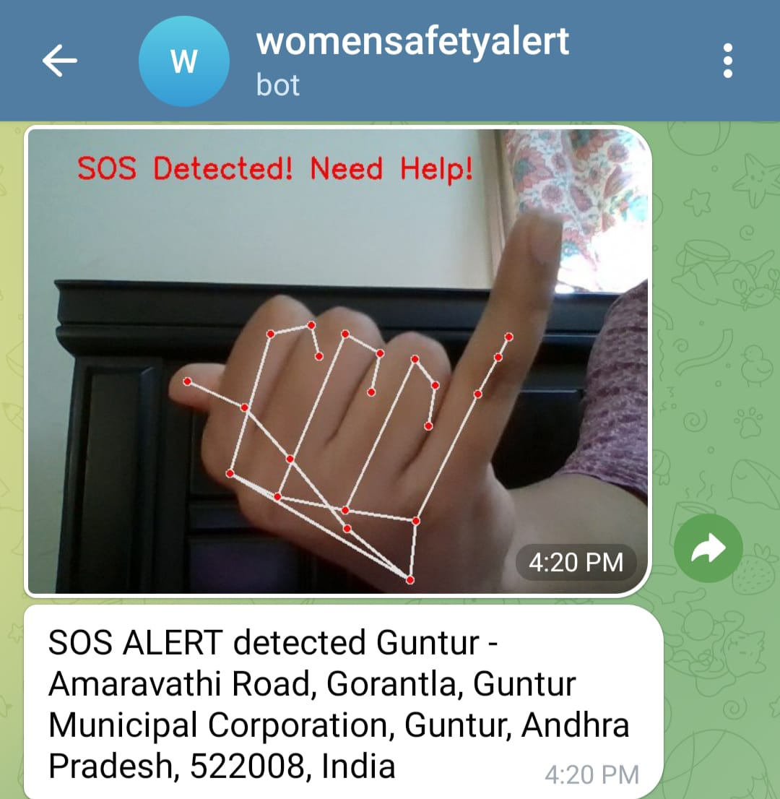
SoS Gesture Detection

Slide 19
Software Requirements
Operating System: Windows/Linux
Programming Language: Python
Libraries & Frameworks:
OpenCV (video processing)
TensorFlow/PyTorch (AI model training)
YOLOv11 (gender and weapon detection)
Mediapipe (gesture recognition)
Flask(Web Framework)
Telegram API (alert notifications)

Slide 20
Hardware Requirements
Processor: Intel i5/i7 or equivalent (AMD Ryzen 5/7)
RAM: Minimum 16GB (32GB recommended)
Cameras: High-resolution CCTV or IP cameras
Webcam or IP Camera
Resolution: 1080p (Full HD) for accurate detection
Frame Rate: 30 FPS or higher
Night Vision / IR support is highly recommended for low-light conditions
Storage: SSD with at least 1TB capacity
Network Connectivity: Stable internet connection.
Required for:
Telegram Bot Ingtegration
Live alerts and GeolocationAPI(geopy + Nominatim)

Slide 21
Applications
Applications of Women Safety Analytics
Public Space Monitoring – Enhances safety in public areas like parks, streets, bus stops, and railway stations by detecting potential threats in real time.
Smart City Integration – Can be integrated with smart city infrastructure to provide automated surveillance and quick emergency responses.
Law Enforcement Assistance – Helps police and security agencies by providing real-time alerts and location-based analytics for faster intervention.
Corporate & Workplace Safety – Ensures a safer environment in offices, IT parks, and workplaces by monitoring gender distribution and detecting distress situations.
Educational Institutions – Enhances security in schools, colleges, and universities by identifying unsafe situations and improving campus safety.
Public Transport Safety – Monitors bus stands, metro stations, and inside public transport to detect distress situations and alert authorities.

Slide 22
THANK YOU

